Slide 1
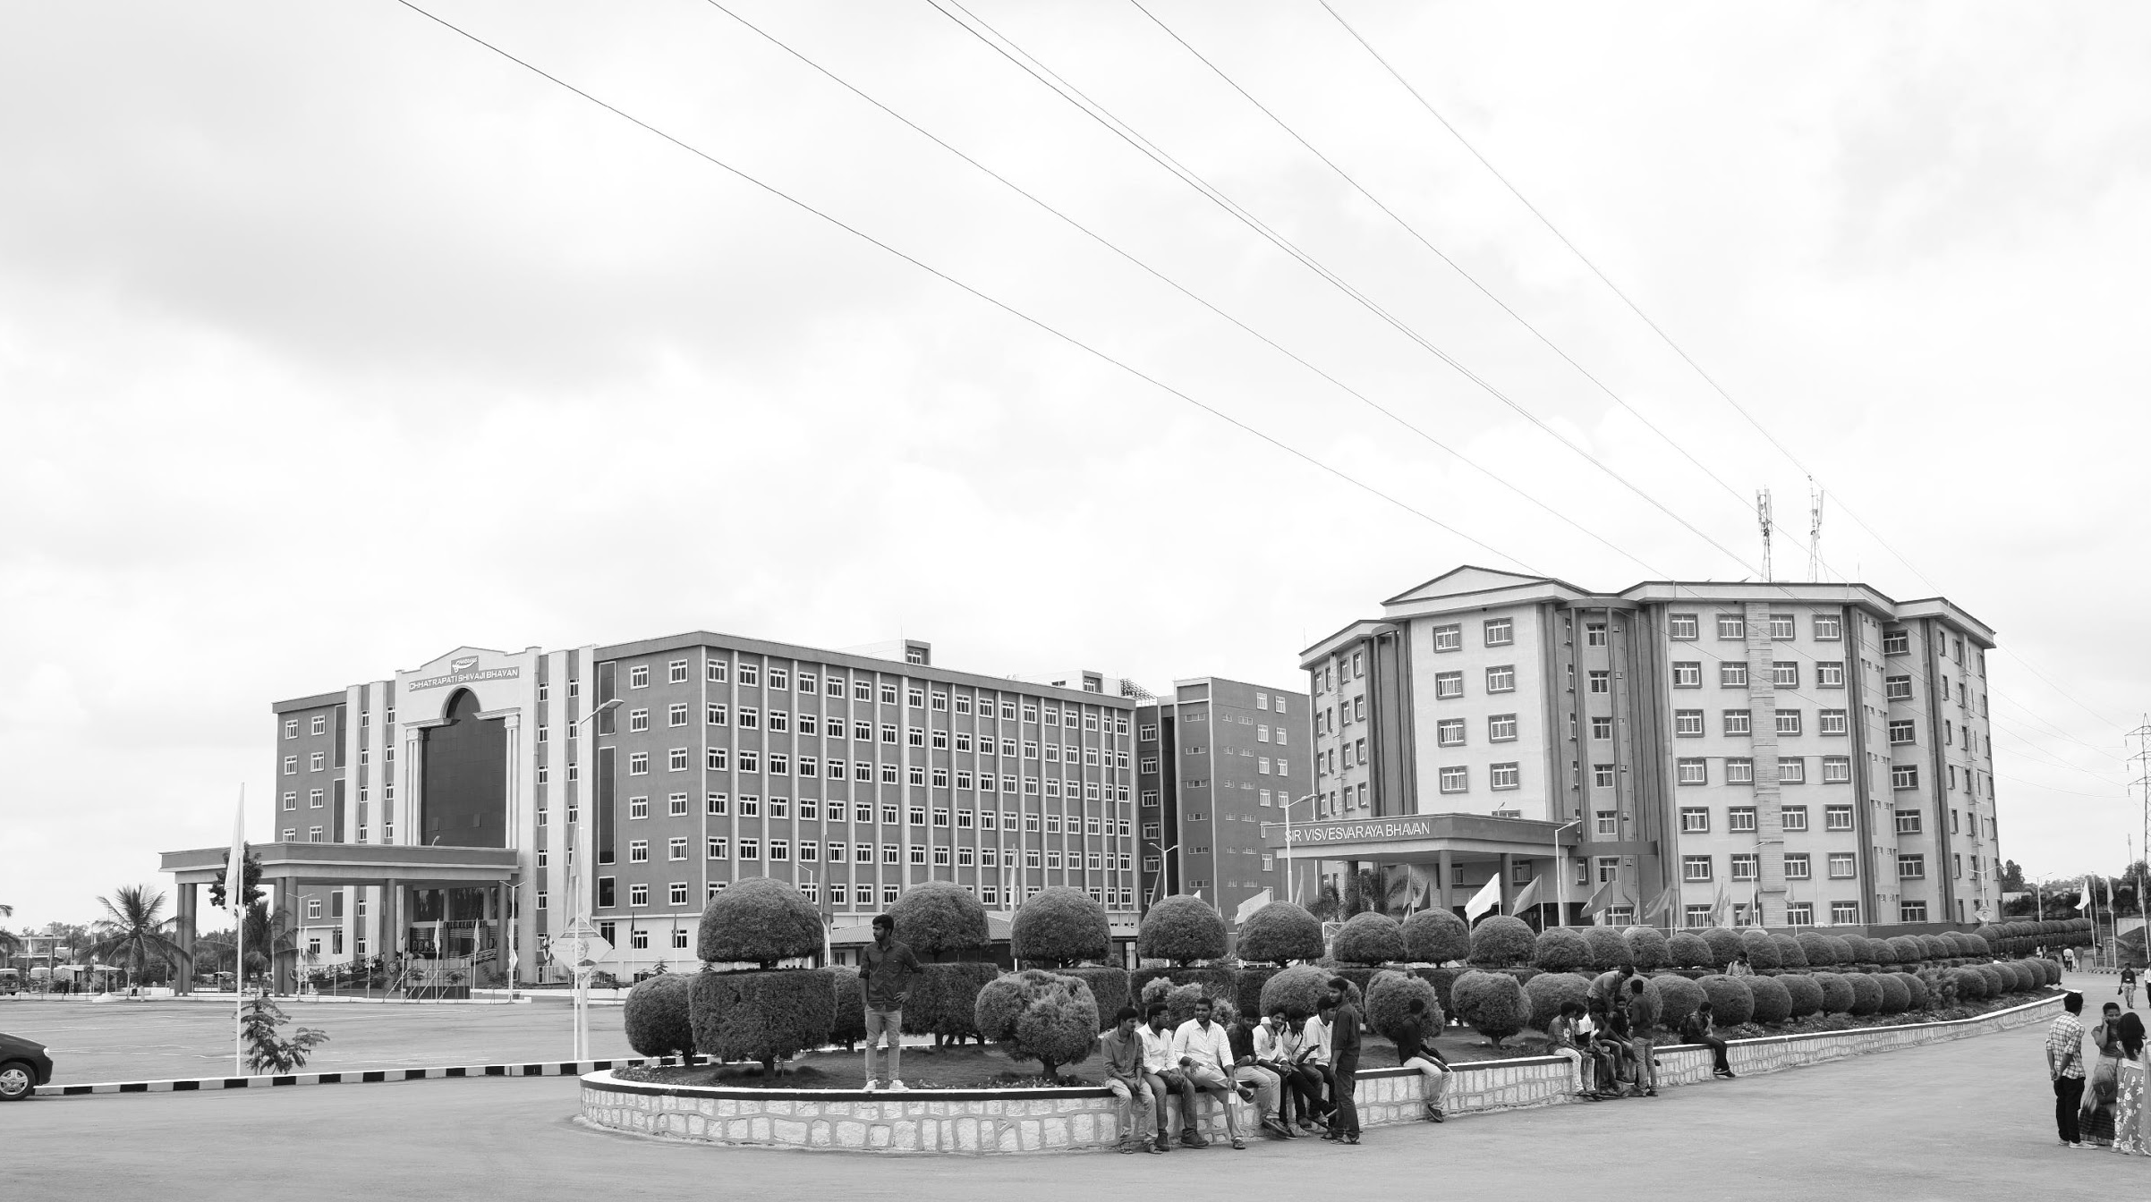

Gesture Sense – An Automated Hand Gesture Control
AY 2020-24
GITAM UNIVERSITY
Major Project
Project ID: 19EEC492
A University should be a place of light, of liberty, and of learning.
Department of Electrical Electronics and Communication Engineering
Project Team:
K. Nikith Gokul
N. Sai Pranay Kumar
V.R. Gayathri
G. Rohith
Project Mentor:
B. Venkata Kranthi
www.gitamedu.com

Slide 2

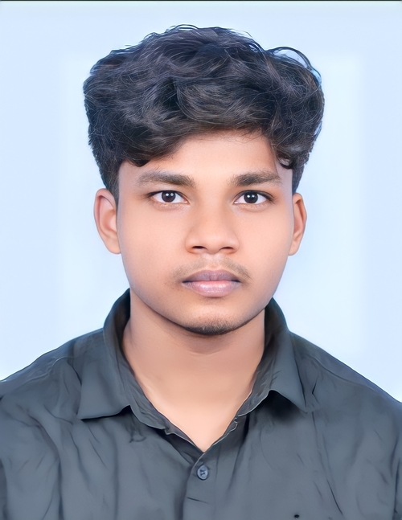
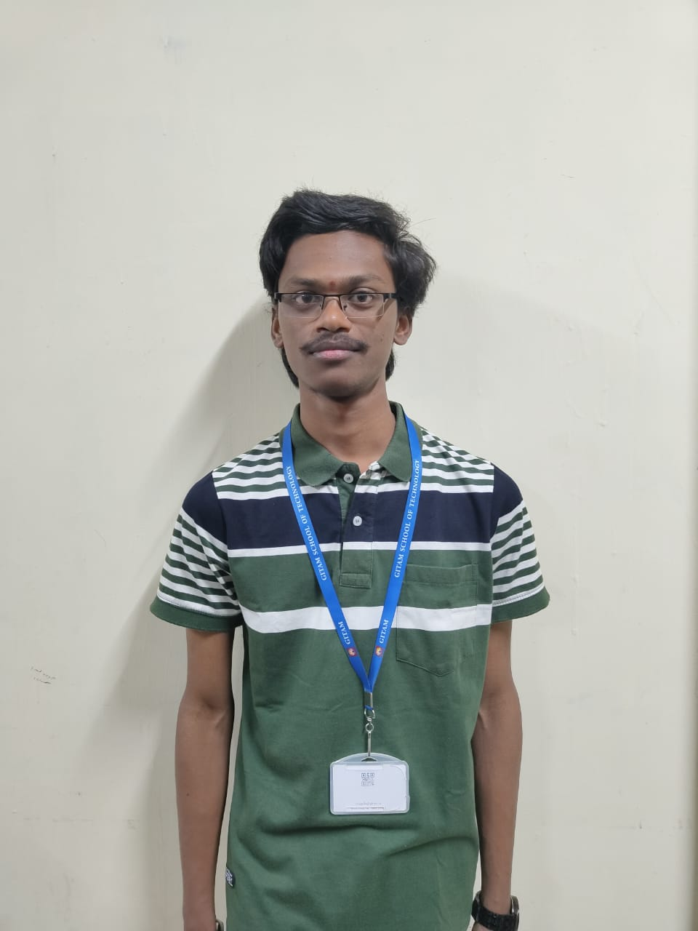
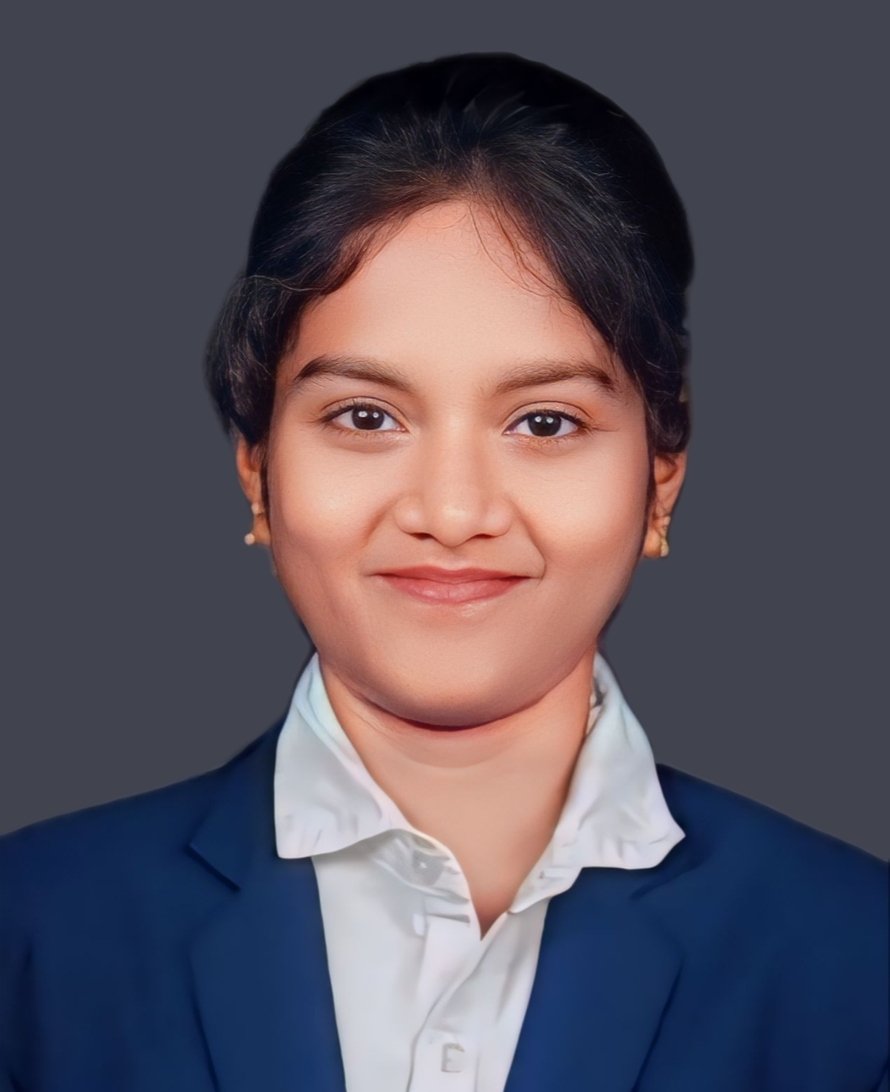
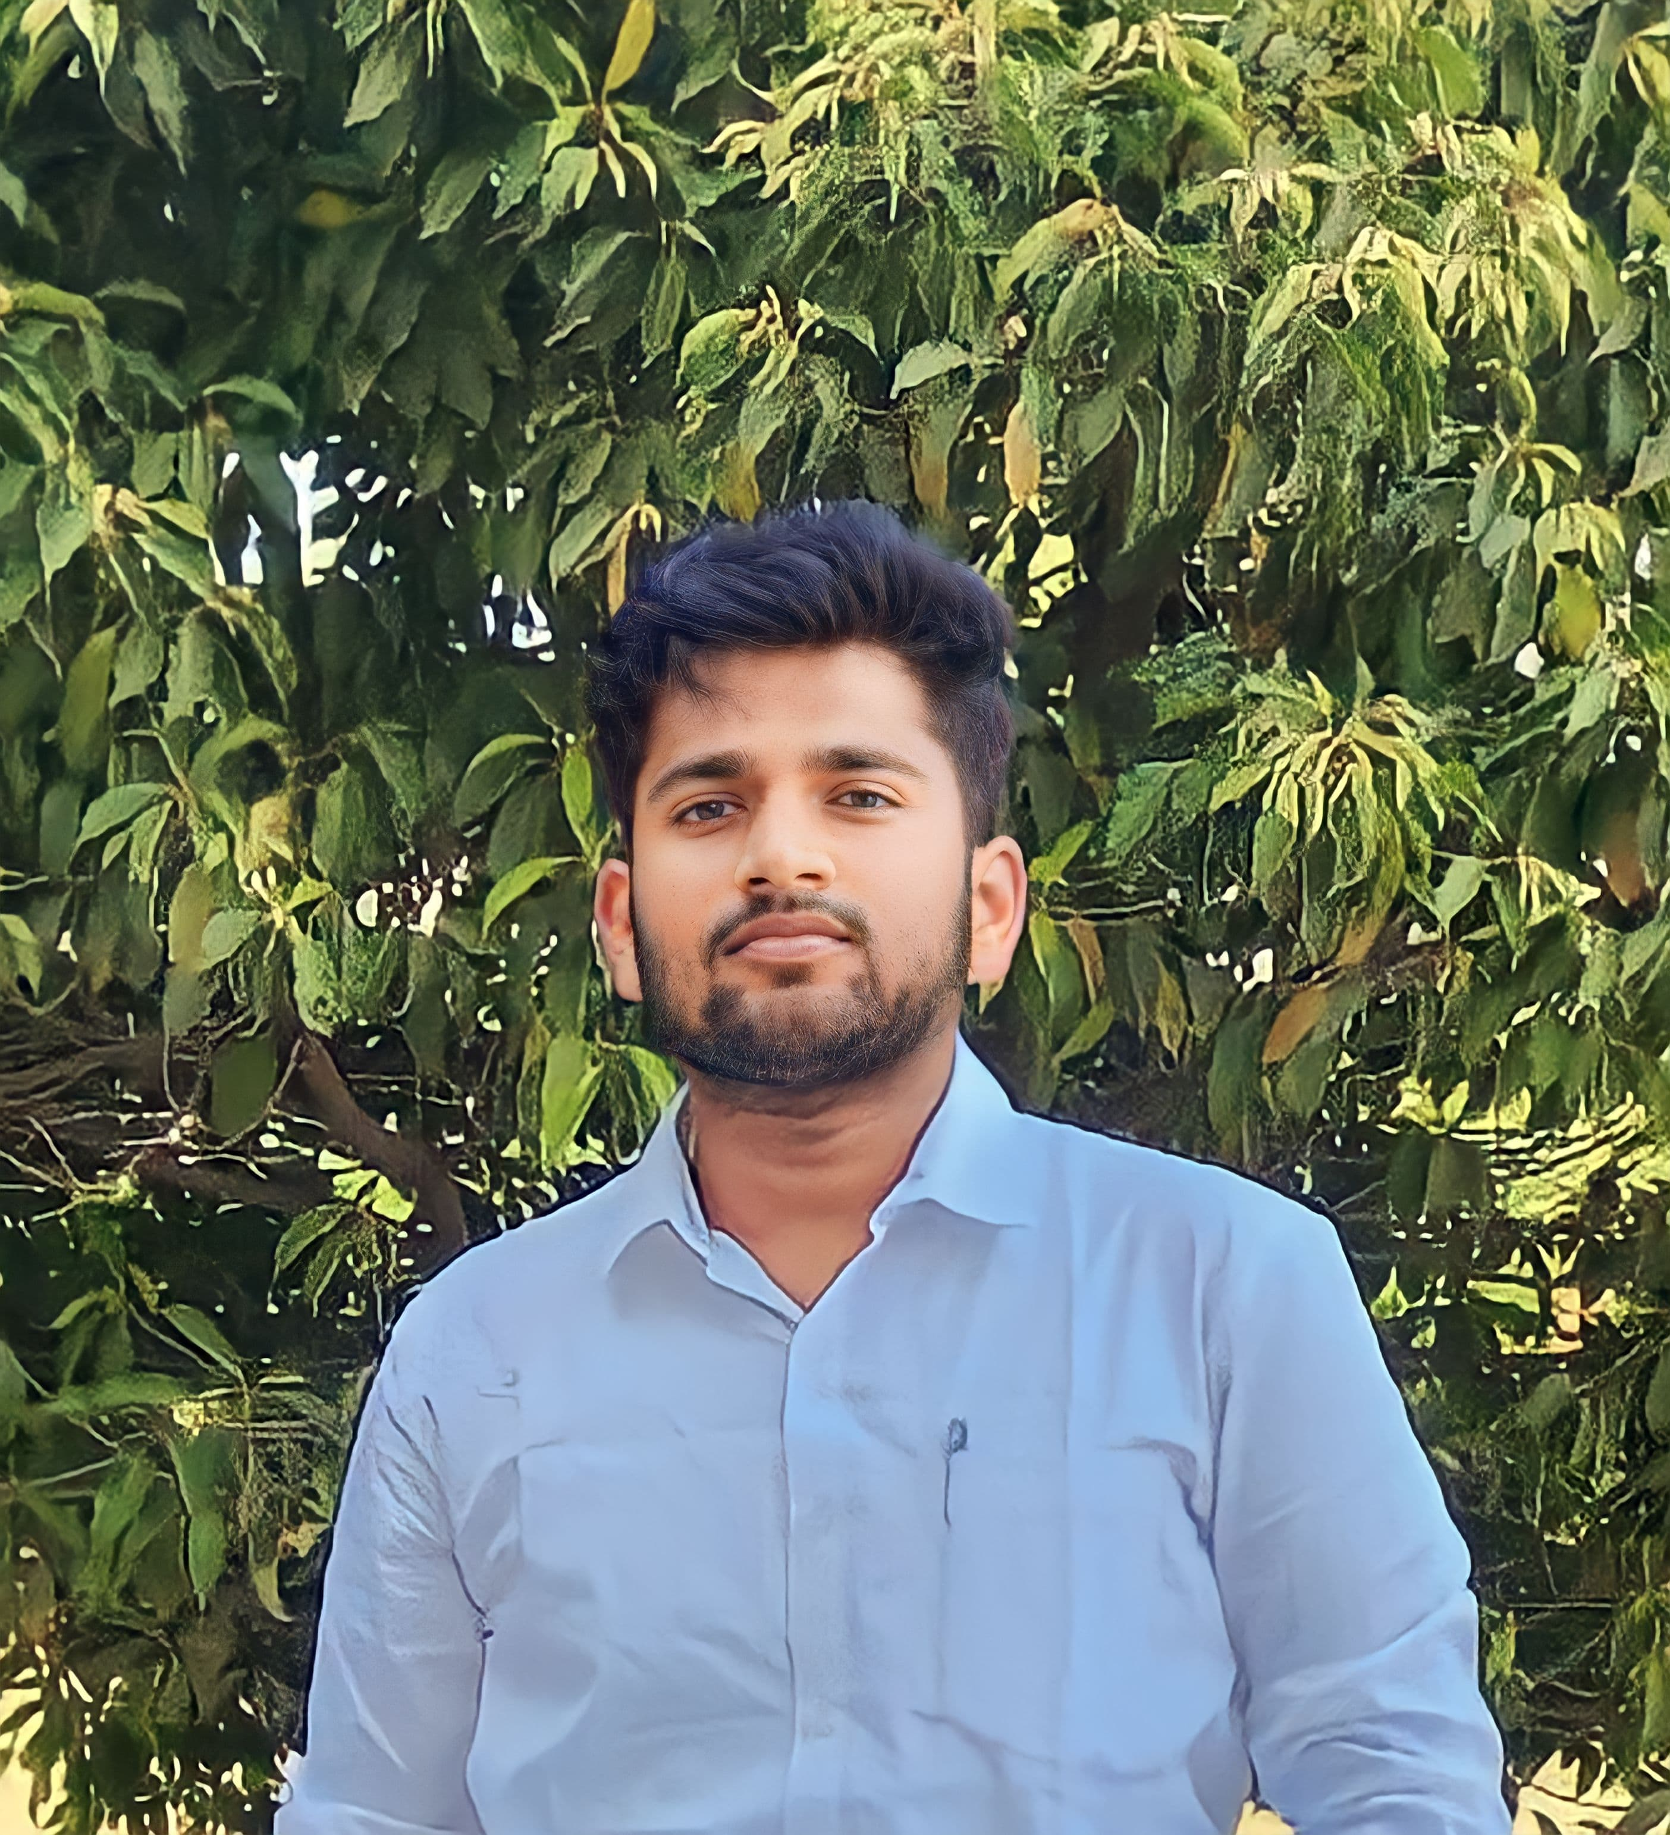
Project Group – Details
Photo
Track
Roll No
Name
EECE AI/ML
322010404003
K. Nikith Gokul
EECE AI/ML
322010404007
N. Sai Pranay Kumar
EECE AI/ML
322010404019
V.R. Gayathri
EECE AI/ML
322010405026
G. Rohith

Slide 3
Objective and Goals
Objective
Our project aims to revolutionize human-computer interaction by creating an intuitive and hands-free gesture control system for laptops.
Goals
Main Goals
Development of a Comprehensive Gesture Control System
Implementation of a Wide Range of Gestures
Exploration of Two Methodologies(OpenCV, Media pipe & Deep Learning)
Managing the applications
Future Enhancements
Additional Goals
User-Friendly Interaction
Reduce the E – waste
Accessibility

Slide 5
Literature Survey
Key Publications
“Hand Gesture Recognition for Human-Computer Interaction”.
“Hand Gesture Recognition on Python and OpenCV”
“Hand Gesture Recognition Techniques”
Key Resources – Whitepaper| Application Notes | Datasheet| Others
The Gaussian Mixture Model (GMM) was used to extract the hand from the video sequence. Based on the movements observed in the previous and next slides, we got an idea to implement it in the music control system using OpenCV.
We employed a Haar-cascaded Classifier to detect the hand gesture before performing image processing. Additionally, we utilized libraries such as Mediapipe and PyAutoGUI.
We plan to explore deep neural networks, including 3D CNN and LSTM, for further refinement and enhancement of the system.
Existing Implementations – Products| Opensource| GitHub etc
https://github.com/waynshang/Gesture-Recognition-with-3DCNN

Slide 6
Analysis - SWOT
Strengths
Weaknesses
1. Innovative Technology Stack
2. Versatile Applications
3. Focus on Accessibility
1. Gesture Recognition Accuracy
2. Learning Curve for Users
3. Dependency on Environmental Conditions
Opportunities
Threats
1. Market Potential
2.Collaboration with Hardware Manufacturers
3. Continuous Technological Advancements
1. Competition
2. Privacy Concerns
3. Technical Challenges

Slide 7
Analysis – 4W1H
Why:
Gesture Sense aims to revolutionize laptop interaction with an AI-based gesture control system, making it more intuitive and seamless for users.
What:
Gesture Sense uses OpenCV, PyAutoGUI, and Media Pipe along with deep learning to control laptops through hand gestures, covering tasks like cursor control, music playback, and brightness adjustment.
Where:
Designed for laptops, Gesture Sense can be used in various settings, including professional, home, or on-the-go environments.
When:
The project is ongoing, continuously improving with technology advancements to enhance gesture recognition accuracy and introduce new features.
How:
By employing computer vision and deep learning, Gesture Sense tracks hand gestures in real-time, ensuring a natural and responsive interaction experience for users.

Slide 8
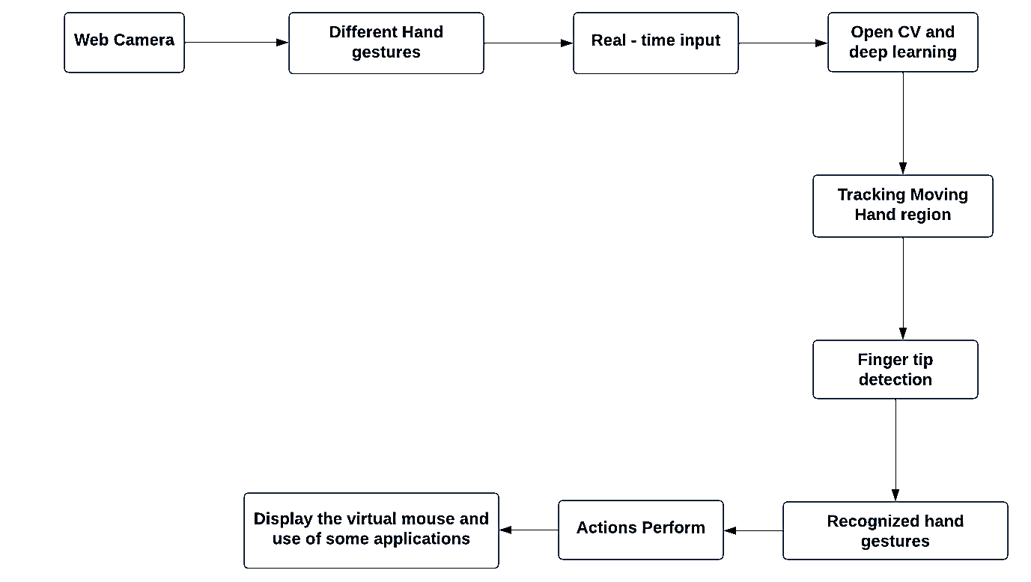
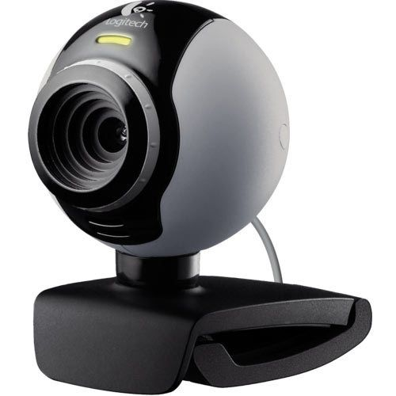
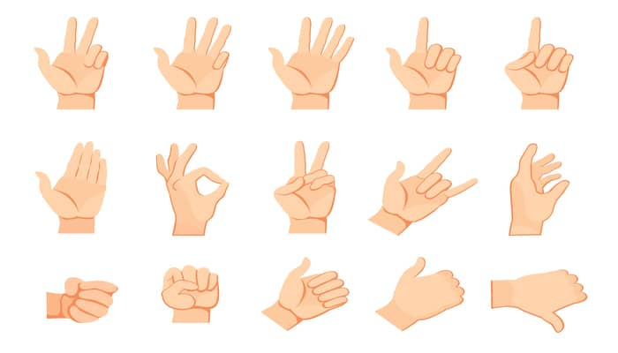
Architecture
Structural Diagram of our project
Approach 1- Using OpenCV & Media Pipe
Open CV
Figure 1. Block Diagram.

Slide 9
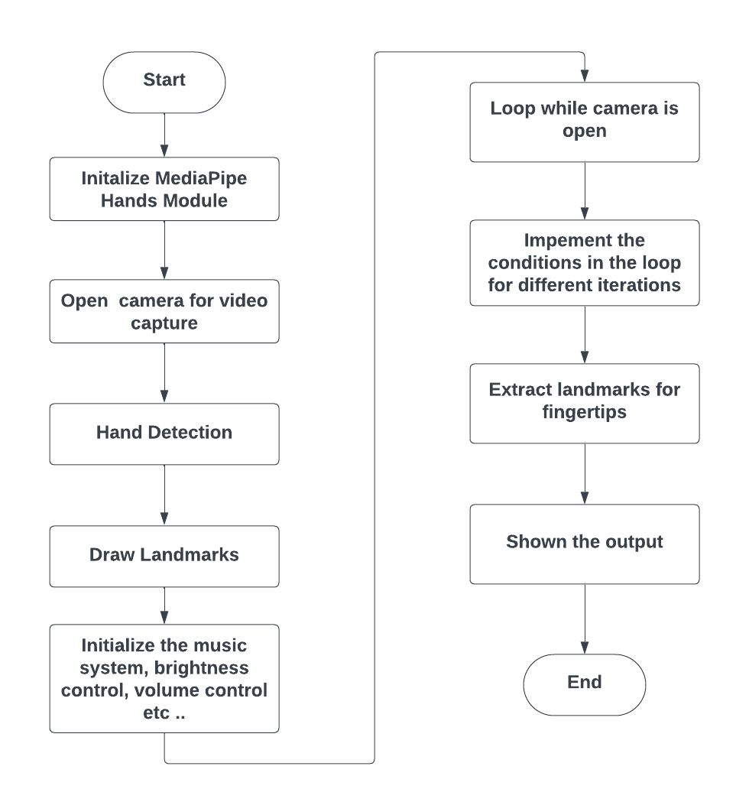
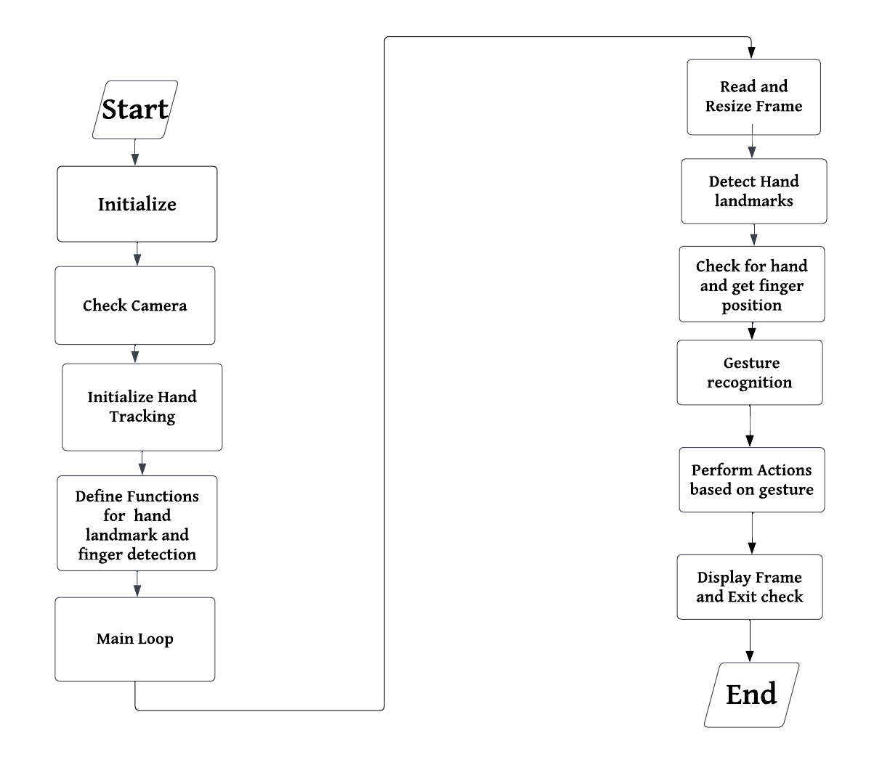
Architecture
Behaviour Diagram of our project
Figure 2. Flow chart for Music System Control
Figure 3. Flow chart for Hill Climbing Race

Slide 10
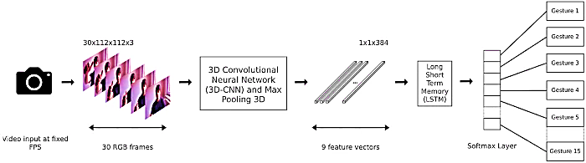
Architecture
Structural Diagram of our project
Approach 2 - Using Deep Learning
Figure 4. Architecture of 3d-CNN and LSTM.

Slide 11
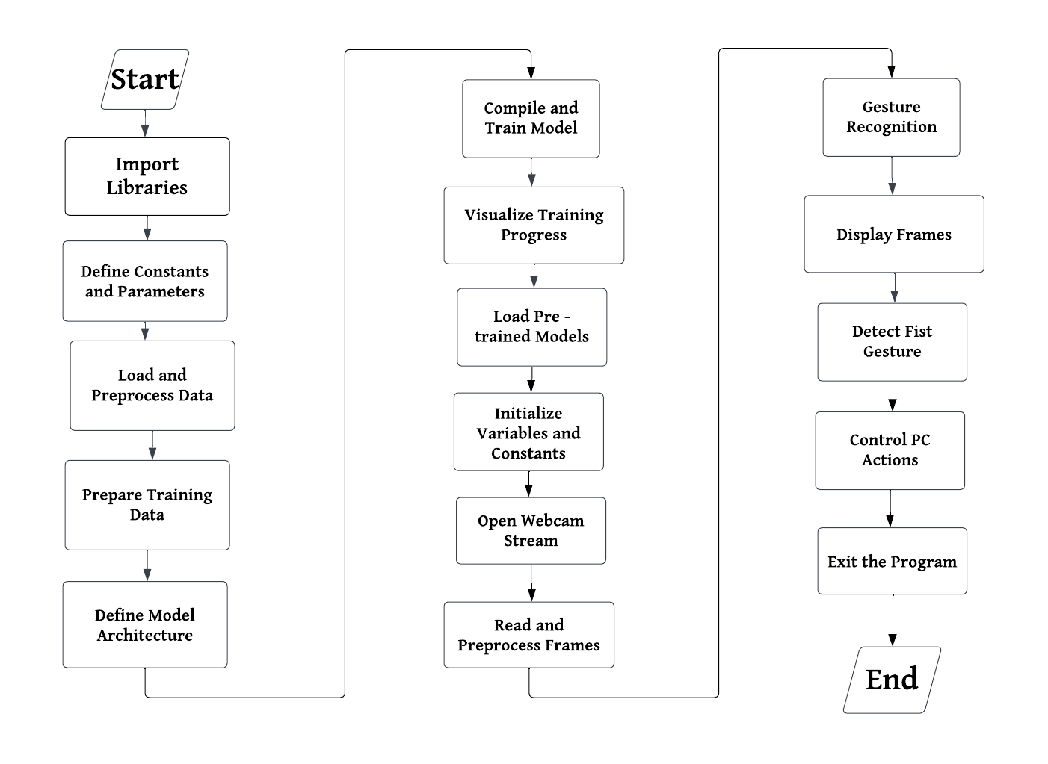
Architecture
Behaviour Diagram of our project
Figure 5. Flow chart for Deep Learning Based Gesture Control.

Slide 12
Use Cases & Testing
Use Cases
Media playback control
Scrolling and Navigation
Zooming
Controlling the Application(Hill Climbing Race & Spotify)
Test Cases
Model Accuracy
Gesture Variability
Adaptability to new gestures
User Experience Testing
Integration

Slide 13
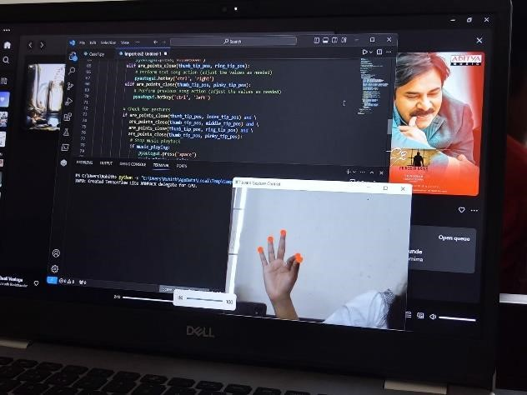
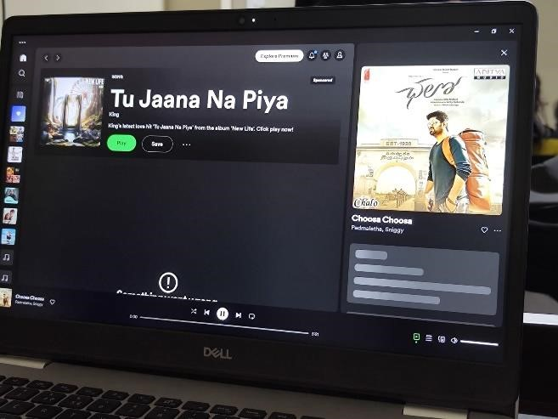
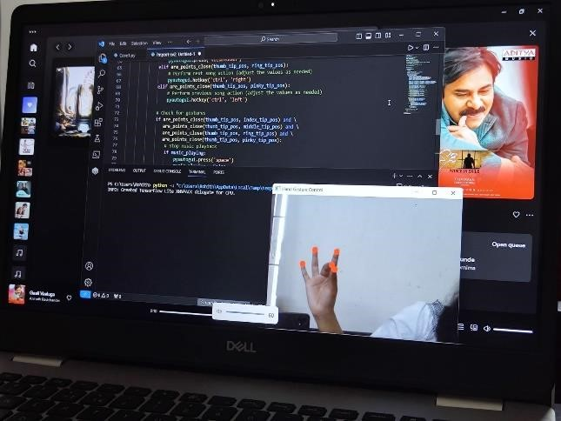
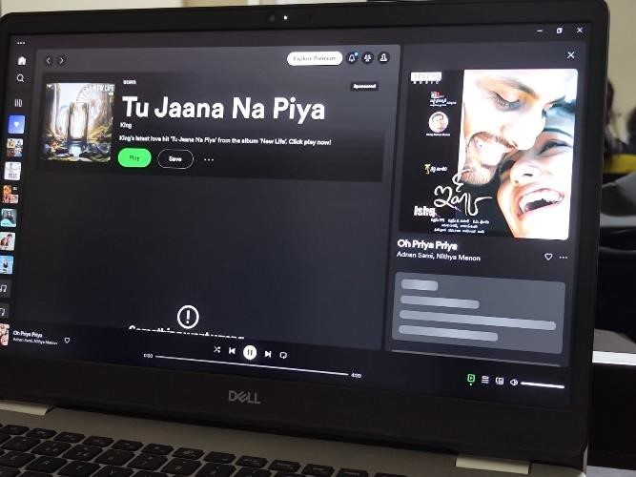
Implementation and Results – Iteration 1
Iteration 1 : Results (Working with open CV and Mediapipe)
Music Control
(Spotify)
Figure 6. Volume up Figure 7. Volume down
Figure 8. Previous song Figure 9. Next song

Slide 14
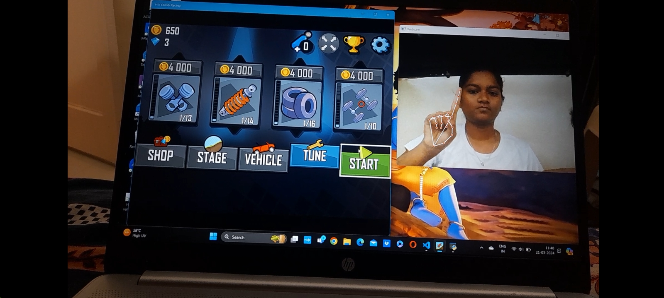
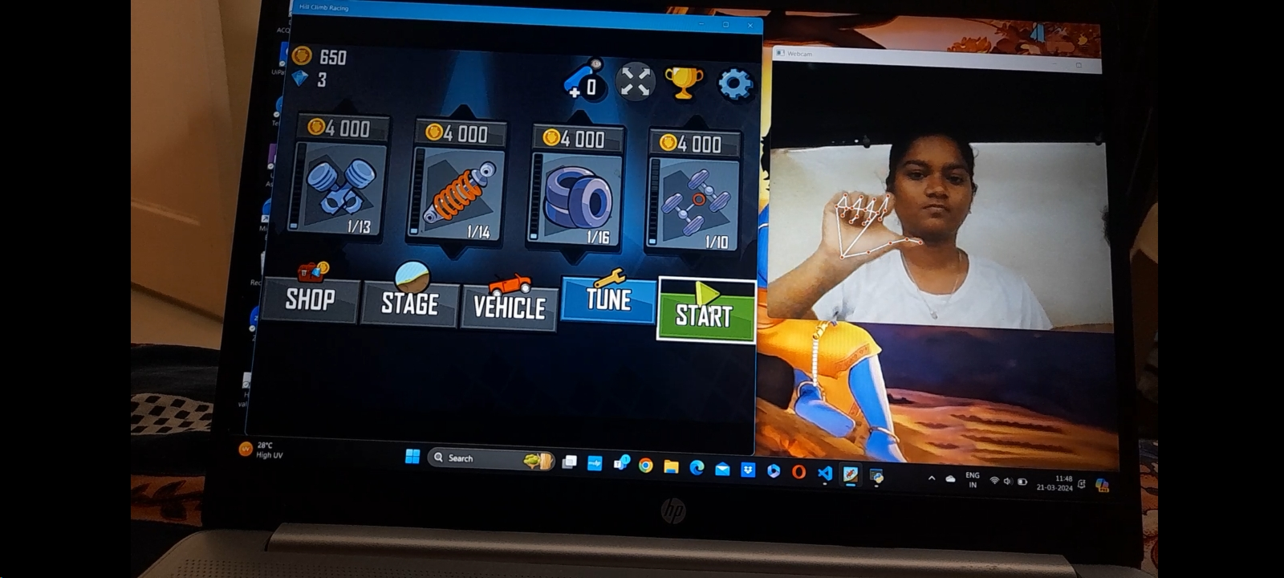
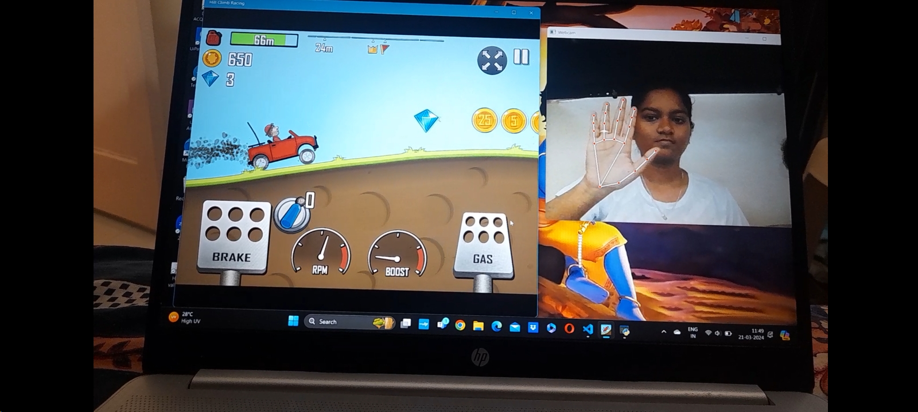
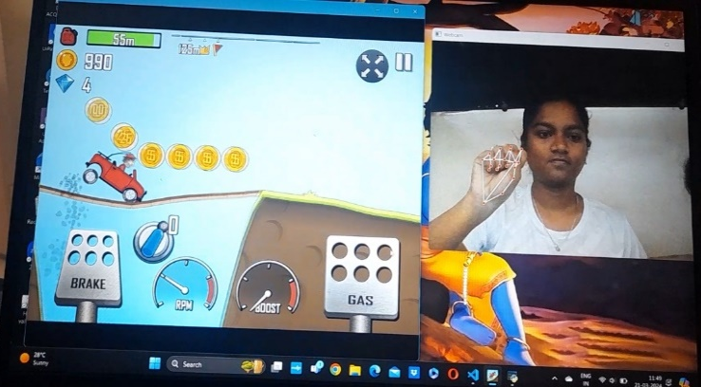
Implementation and Results – Iteration 1
Iteration 1 : Results (Working with open CV and Mediapipe)
Figure 10. Cursor Figure 11. Click
Hill Climbing Race
Figure 10. Accelerator Figure 11. Brake

Slide 15
Validation against the use cases and test cases

Slide 16
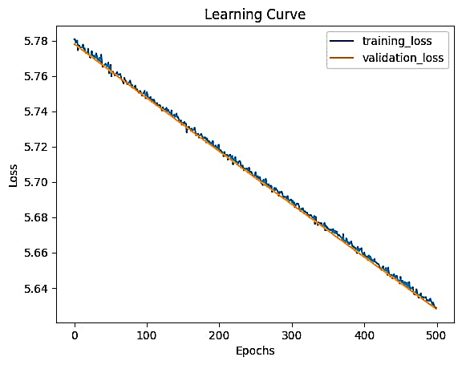
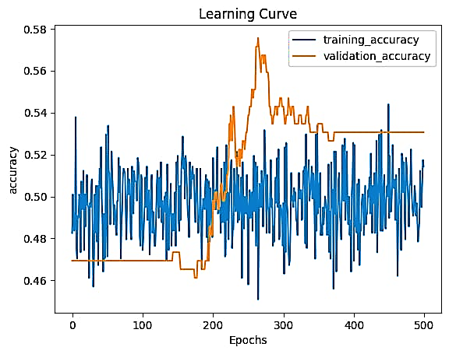
Implementation and Results – Iteration 2
Iteration : Results (Working with the deep learning based approach)
Working with the sequence of images.
1200 Images per gesture is used for the training purpose.
Architecture comprises of 1-3dCNN and 3- LSTM layers.
Figure 12. Graph showing Training loss and validation loss. Figure 13. Graph showing Training accuracy and validation accuracy.

Slide 17
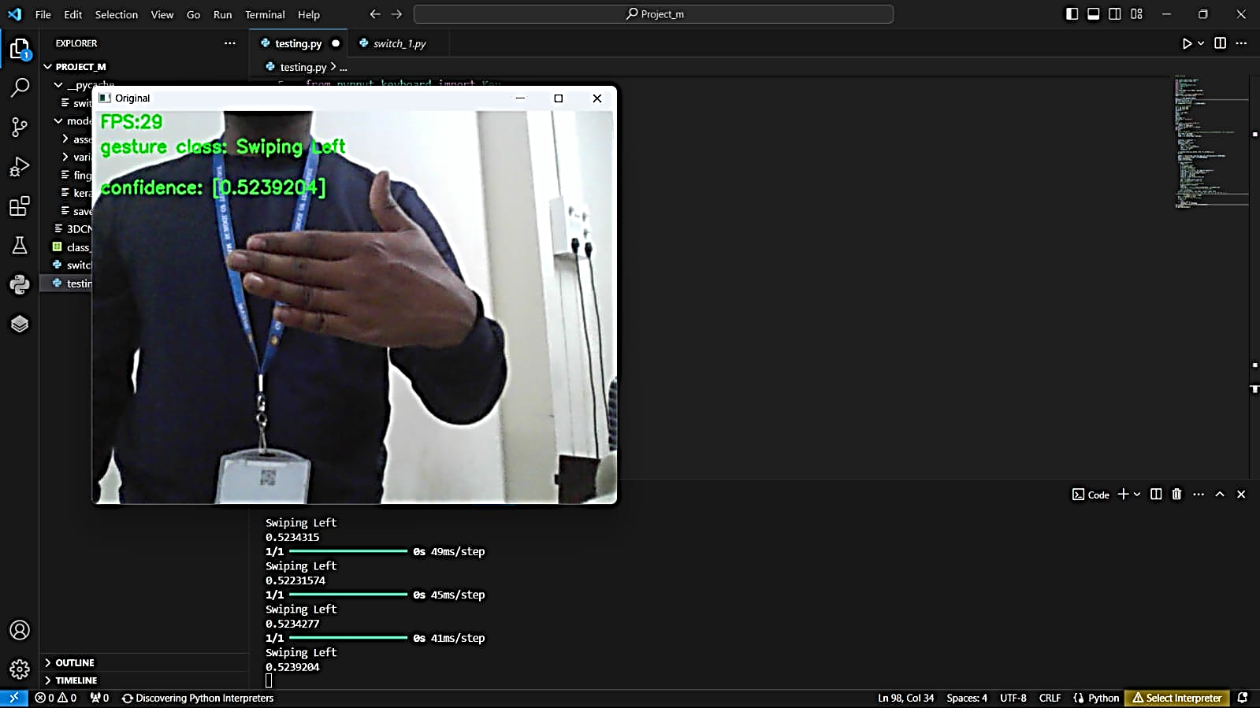
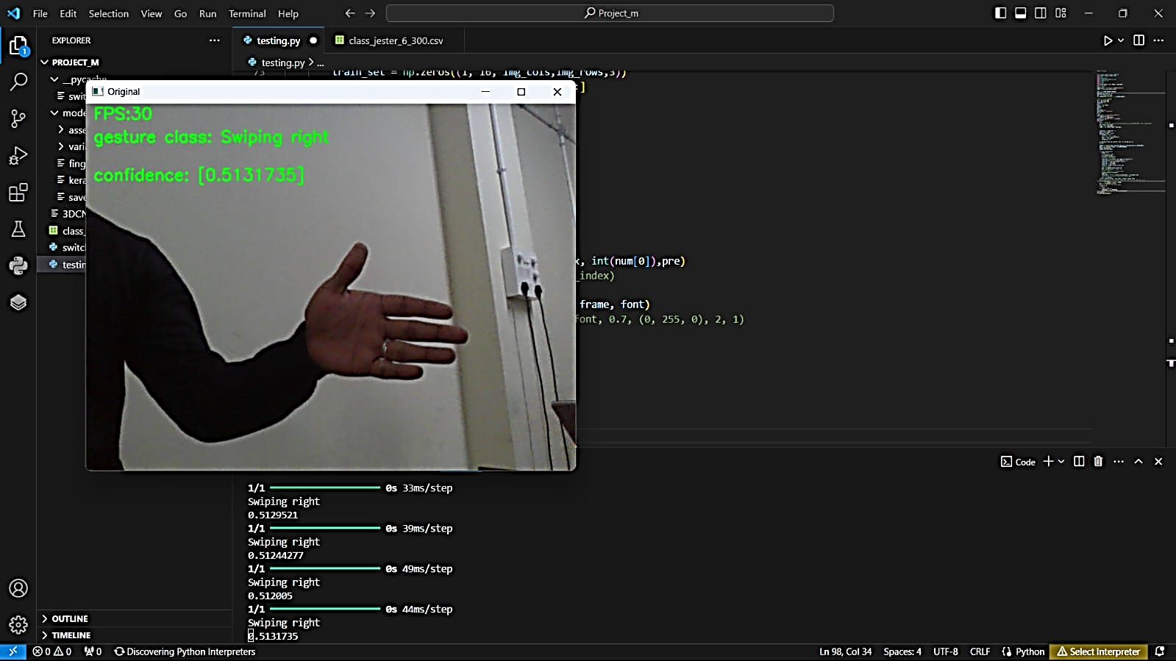
Implementation and Results – Iteration 2
Iteration : Results (Working with the deep learning based approach)
Figure 14. Swiping Left. Figure 15. Swiping Right.

Slide 18
Validation against the use cases and test cases

Slide 19
Contribution
Team Progress and Movement
Completed:
Developed gesture recognition using OpenCV, MediaPipe, and PyAutoGUI for various applications such as brightness control, cursor movement, music control, slider adjustment, and Chrome opening.
Gathered the datasets for deep learning-based approach.
Selected the model architecture for deep learning-based approach (3D-CNN & LSTM).
Currently training the model with the datasets.
Identified the applications that will be controlled by the end of the project.
Analyzed both the approaches.
Obtained the results using Deep Learning Based approach.
Controlled the Application.

Slide 20
Contribution
Individual Contribution
Key contributions: K. Nikith Gokul
Spearheads the ideation phase, meticulously plans gestures, and designs models for effective implementation.
Leads the exploration of 3D-CNN and LSTM for deep learning-based gesture recognition, assessing the feasibility and efficiency of this approach.
Key contributions: N. Sai Pranay Kumar
Demonstrates proficiency in architecture development, meticulously analyzes algorithms.
Ensures the seamless integration of various features to enhance the project's functionality and usability.
Key contributions: V.R. Gayathri
Leads the programming efforts involving OpenCV and MediaPipe methods, and crafts precise gesture codes tailored for specific functionalities to enhance user experience.
Focuses on applications that can be entirely controlled by gestures, ensuring seamless integration and functionality.
Key contributions: G. Rohith
Drives the documentation process, rigorously tests models for efficiency, and actively solicits and incorporates user feedback to refine the project's capabilities and performance.
Additionally, leads the data collection and preprocessing efforts, laying a strong foundation for data-driven insights.

Slide 21
Conclusion & Future Work
Summary and Conclusion
In conclusion, both OpenCV/MediaPipe and deep learning-based approaches offer effective gesture control solutions, each with unique strengths.
OpenCV/MediaPipe with PyAutoGUI is straightforward, offering real-time performance and ease of implementation. It excels in precise hand tracking and is ideal for tasks like media control or UI navigation.
Deep learning-based methods are suitable for complex gestures and varied environments. They shine in demanding applications such as sign language interpretation or virtual reality interactions.
Future Work
Multi-modal Fusion: Integrate multiple sensors like depth cameras with visual-based gesture recognition to enhance accuracy and resilience.
Cross-platform Compatibility: Develop gesture control solutions compatible across various devices and operating systems for seamless integration.
User-Centric Design: Conduct user studies to design intuitive gesture interactions based on user preferences and behaviors.
Domain-specific Applications: Explore gesture control applications in industries like automotive interfaces and virtual reality for unique efficiencies.
Ethical Considerations: Address ethical concerns such as accessibility and biases in gesture recognition algorithms for widespread adoption.

Slide 22
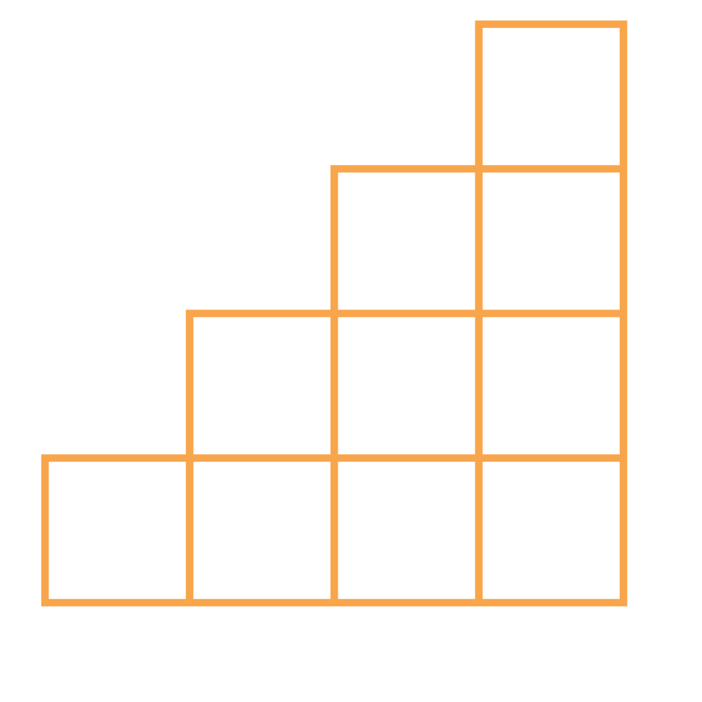
THANK YOU

